Slide 1
Maturity Model for Microsoft 365 Practitioners
How to run a MM4M365 Workshop
July 2021
⭐Guest stars⭐ You!
Emily Mancini, Sympraxis Consulting | @eemancini Marc Anderson, Sympraxis Consulting | @sympmarc
Simon Doy, iThink 365 | @simondoy
Simon Hudson, Novia Consulting | @simonjhudson
Initiative started by Sadie Van Buren as SharePoint Maturity Model in 2010
Notes:
EMILY

Slide 2


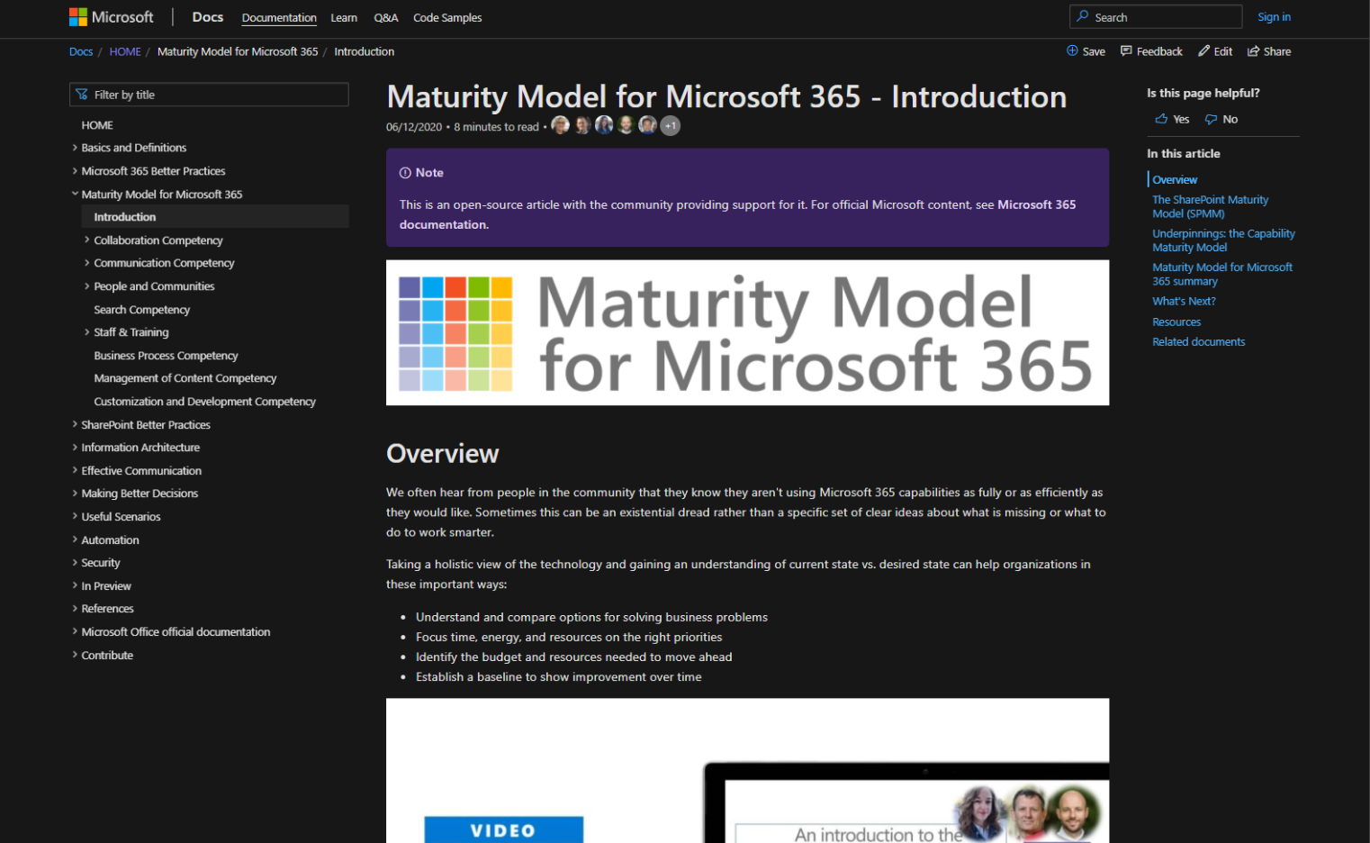
v
Agenda
Practitioner & Maturity Model overview
Artifacts and Updates
Purpose
How to get more involved
Shout-out & Picture Time (Together Mode!)
Discussion: How to run a MM4M365 Workshop
Notes:
EMILY

Slide 3

The approach and articles on Microsoft Docs
https://aka.ms/m365-community-docs
Artefacts
Improve organization through use of technology
Benchmark company and department
Select appropriate approach
Develop an organizational business and technical roadmap based on:
What's possible
What's desired
Organization's culture and drivers
Lead and support strategic planning, with senior management
Align implementation needs and objectives
Discuss use of the platform with IT – not just technology
Socialization tool
PURPOSE
Published Competencies
Open Competencies
Supporting Articles
Business Process
In progress
Principles of…
Infrastructure
Collaboration
Search
Communication
Communication
To do
Management of Content
Security…
How to elevate…
People & Communities
Data & Analytics
Collaboration
Search
Communication
Staff & Training
People & Communities
Customization & Development
Staff & Training
Notes:
SIMON H

Slide 4
MM4M365 provides benchmarks to measure your organization
Maturity Level | Description | Keywords
Level 500 Optimizing | Deliberate and systematic process improvement/optimization Focus is on continually improving process performance Addressing statistical common causes of process variation and iterative process improvement | Optimal, systematic, statistical, improvement-focus, automated, assured, proactive
Level 400 Predictable | Actively managed in accordance with agreed processes and has tracked metrics Effective achievement can be evidenced across a range of operational conditions Process has been tested and refined Process users demonstrate competence | Productive, interactive, responsive, enhanced, effective, adaptable, quality
Level 300 Defined | Defined and standardized Signed off, managed process Limited validation of effectiveness, doesn’t include edge cases Process users demonstrate familiarity | Documented, policy-driven, planned, controlled, stable
Level 200 Managed | Key processes defined but not standardized, uniformly or strongly applied Some ability to demonstrate consistent outcomes Limited buy-in from staff and management Widespread inconsistency and resistance | Routine, legacy, fire-fighting, variable, personally managed
Level 100 Initial | Default, starting/exploratory state People driven processes, lacking documentation and discipline Many ways of doing the same thing (with variable results) Characterised by inefficient legacy approaches and pockets of unmanaged innovation | Ad hoc, reactive, uncontrolled, chaotic, unstable, not designed
Source: https://docs.microsoft.com/en-us/microsoft-365/community/microsoft365-maturity-model--intro
Notes:
SIMON H

Slide 5
Purpose
Discussion-based monthly meeting
Highlights of new assets
Understanding the competencies
Mapping technology to maturity levels and competencies
Running a workshop
Measuring maturity
Sharing anecdotes and success stories
Feedback on the maturity model
Safe space to hone your pitch, test your thoughts, or decide how to promote your use of the Maturity Model
OVERVIEW
Practitioners for
Maturity Model
for Microsoft 365
Get Involved
https://aka.ms/sharing-is-caring
Present case study (at MM4M365 Practitioners or other speaking opportunities)
Contribute on GitHub
Provide feedback, insights, tools, and artifacts
Socialize
content
Notes:
EMILY

Slide 6
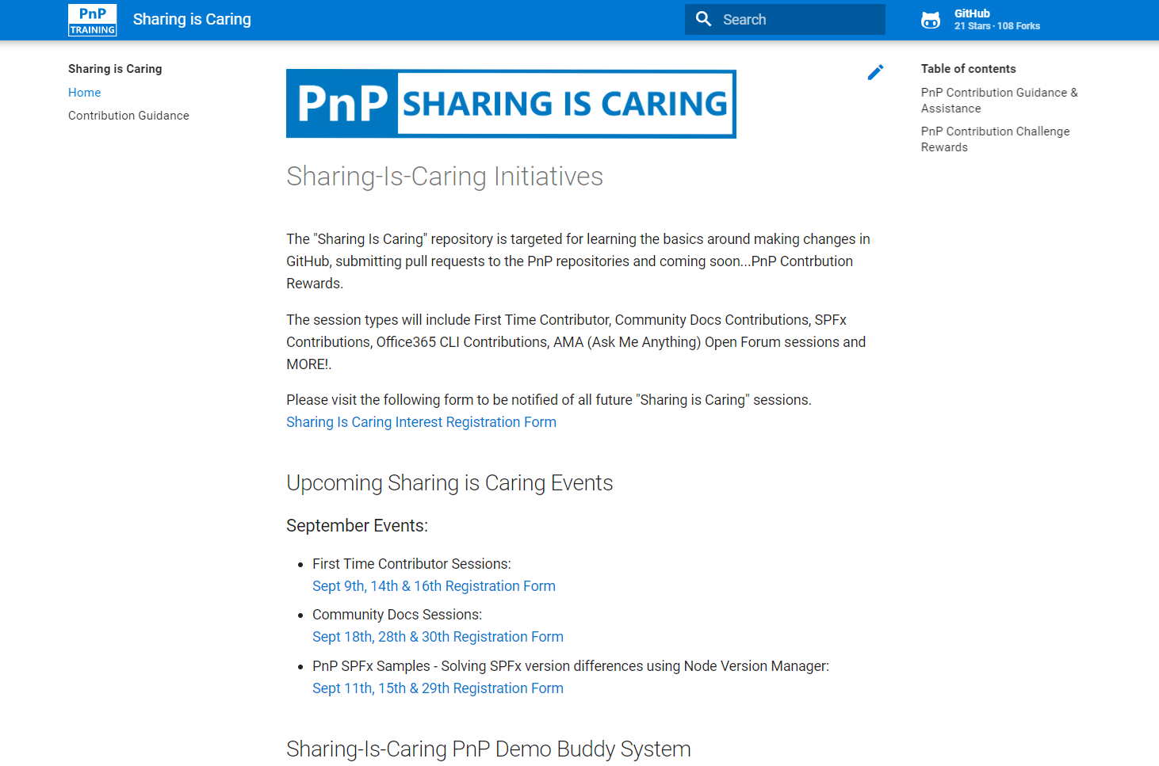

GUIDANCE
Get started on the open-source and community work?
Community Docs Sessions
Wednesday, June 23rd
First Time Contributor Sessions
Tuesday, June 29th
Thank you, June attendees
David Warner
Kathleen Boilek
Shilpa
Ariel Smith
Ralph Rivas
Theresa Lubelski
Susan McClements
Ron Jones
Alex Tabone
Simon Ågren
Nikki Chapple
Chris Revell
Andrew Burns
Patrick Tucker
Ross Allan
Henrik Yllemo
Julie Peck
Daniel
Shiva Bezwada
Melissa Declercq
Harold Wolfinger
Phil Broadbery
Nizar Grindi
Rocio Holub
Pete Simpkins
Kiran Bellala
Prabhjit Singh
Andy Boylan
Mike Duffy
Lance Yoder
Christine Green
Manjunath Puttaswamy
Tammie Brown
Daniel Westerdale
Michael Appinger
Next MM4M365 call
August 17th at 7:00am PST
Third Tuesday of every month
https://aka.ms/sharing-is-caring
TBD
https://aka.ms/sharing-is-caring
Notes:
EMILY

Slide 7
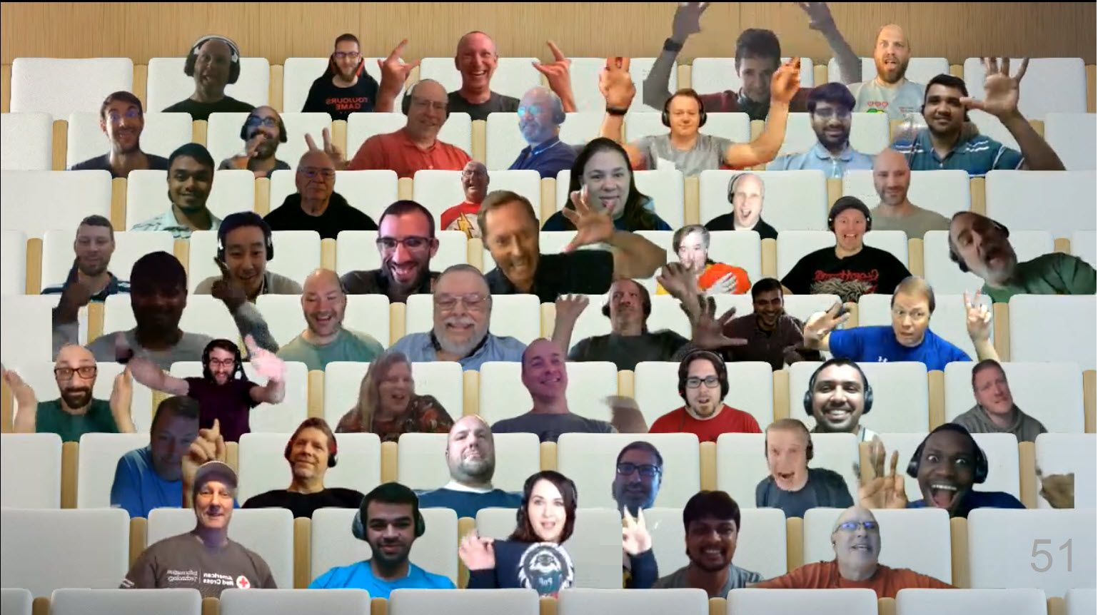

PnP Picture Time!
Video on and we’ll grab a Together Mode pic with everyone who wants to be seen to be here.
We are together in this as a community!
Notes:
EMILY

Slide 8
To Record or Not Record?

Slide 9

DISCUSSION
How to run a MM4M365 Workshop
PROTOCOL
Visually emote and support Share reactions while others are speaking
Come off mute and share your thoughts
Share your camera (don’t be shy)
Raise your hand to say your piece (and put it down again!)
Notes:
SIMON D
Discuss the approach and how when first thinking about how to apply the maturity model it was all about the customisation and development competency. So when we are discussing the Power Platform we are think ingabout all the competencies and how they are applied from the maturity model.
Examples:
Communication – how do we inform people that the Power Platform is available? How we explain what the benefits and impact of the platform can be?
Staff and Training – how we we enable our teams to take advantage of the platform? What training is there, do we sign post to internal teams, external teams, on-line resources, do we buy courses via content providers such as linda.com or pluralsight or linked in learning....
Management of content – how do we manage the content related to the Power Platform the user guides / admin guides
People and Communities – we will talk about this more later but how do we enable people and communities around the Power Platform flourish and build a support network for the Power Platform citizen developers
Business Process -
Collaboration – How do we enable people to work together on these systems and describe what they want, what has been done etc.
Before we get into the discussion lets talk about what the Power Platform is.

Slide 10
Discussion
We are going to do a bit of a Show and tell
A suggested set of agendas, tools and approaches
What is wrong and right?
What have we missed?
What else have people done?
Who has sharable resources
Does it scale up and down?
Is this helpful?
Notes:
POLL: https://forms.office.com/r/DmUk6zw2NZ
Would you choose a particular part of the platform?
Source control?
Switch it on and let everyone go wild?

Slide 11
Challenges when planning and running a workshop
Microsoft 365 is slightly HUGE
It’s really complex
It’s difficult to know where to start
It will take a long time
People will be overwhelmed or lack commitment
People want to run before they walk
Not everyone sees the benefit in benchmarking/establishing a base line before jumping in
“Can’t we just do it?”
“Wouldn’t it be better to focus on what the technology can do?”
Different levels of seniority/different roles and skills will have a different view
People see the need through the lens of their own role and experience
People think it’s ITs job to make the company more mature (Hint. It’s not)
Staff will often defer to managers and managers to directors, rather than expressing their view
Every business and culture is different.
It’s hard to get everyone together to do a deep dive and keep them on mission if you do
And there are probably others
Notes:
POLL: https://forms.office.com/r/DmUk6zw2NZ
Would you choose a particular part of the platform?
Source control?
Switch it on and let everyone go wild?

Slide 12
Approach
The Proposal
Start with the ‘Why’
Clarify the purpose; it’s all about making the business more successful
Investigative workshops to develop an action plan
De-emphasise the technology and make it a business need with business driven competencies (underpinned by M365 technologies)
Initial workshops - Helicopter view
Start with a fast, simple workshops
Judgement based workshop tool
Focused on a getting a sense of all the competencies across the organisation.
Identify areas of weakness and excellence around competencies and teams/processes
Define strategy
Where should the company be in general
Which competencies are most in need
Which teams and processes need attention
Where do we have pockets of expertise
Agree an action plan (deep dive) and review cadence
Follow up workshops - Deep dive
Work with teams and processes identified above to look at their specific issues
Identify critical competencies
Run deep dive, Characteristic Assessment based workshops to pinpoint areas to improve
Develop action plans, with targets and ownership
Progress Workshops
Future workshops, based on the above, to assess progress towards strategy
Needs, strengths and weaknesses
Decide who it needs pitching to/who the stakeholders are
Notes:
POLL: https://forms.office.com/r/DmUk6zw2NZ
Would you choose a particular part of the platform?
Source control?
Switch it on and let everyone go wild?

Slide 13
Proposal/getting approval
Start with the ‘Why’
Review the MM4M365 Introduction
Clarify the purpose
It’s all about making the business more successful with the tools you already have
Often as much a people thing as a technology thing
Investigative workshops to develop an action plan
Needs, strengths and weaknesses
De-emphasise the technology and make it a business need with business driven competencies (underpinned by M365 technologies)
Decide who it needs pitching to/who the stakeholders are
Set the expectations for attendees
Participate, be open, there are no wrong answers, it’s about consensus not seniority
Bring examples of content, artefacts, issues and opportunities
What takes too long, is annoying, costly or annoys us or our customers.
Notes:
POLL: https://forms.office.com/r/DmUk6zw2NZ
Would you choose a particular part of the platform?
Source control?
Switch it on and let everyone go wild?

Slide 14
Overview workshop - Helicopter view
Start with a fast, simple workshops
Judgement based workshop tool
Focused on a getting a sense of all the competencies across the organization.
Identify areas of weakness and excellence around competencies and teams/processes
Define strategy
Where should the company be in general
Which competencies are most in need
Which teams and processes need attention
Where do we have pockets of expertise
Agree an action plan (deep dive)

Slide 15
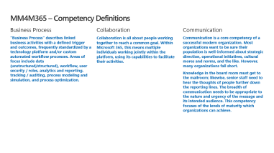
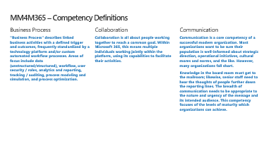
Set the expectations for attendees
List the competency areas with definitions
Acknowledge the competencies where you are at lower levels in order to do better
Participate, be open, there are no wrong answers, it’s about consensus not seniority
Bring examples of content, artefacts, issues, and opportunities
Be ready to discuss:
What takes too long
Is frustrating, costly, or annoys us or our customers

Slide 16

Overview instructions
Set up
Enter your organisation name in the Organisation field on the Data Capture worksheet.
Decide whether the assessment is for the Company as a whole or for a range of Teams, Departments or Processes. State this in the Scope field. Remove/Cross out any Competencies you are not going to focus on"
Running the workshop
Familiarise everyone in the group with the criteria for achieving each level, using the 'Maturity Model for M365' level descriptions and keywords, in conjunction with the Introduction document (link below). These are reproduced below. It is suggested that these levels are made available to all workshop participants.
Now consider the definitions for each Competency. Links are provided on the Data Capture sheet. As a group, form a consensus for each competency for the company as a whole or each department etc. If undecided, choose the midway point between levels. Note: the criteria should be applied strictly - you might be using lots of powerful features, but if these are not agreed, standardised and broadly adopted then it's unlikely level 300 had been achieved, for example.
Enter this value in the Current Assessment column for that sub-competency on the Data Capture sheet
Now review the higher level criteria and reach a consensus on what the level is that the business should be mostly operating at in a year's time. This MUST be a multiple of 100 - no half way positions.
There may be parts of the business that need to operate at a higher (or lower) level than the general one, in which case note these exceptions and the reasons why.
Continue until you have completed each Competency.
Note:
It is often useful to run separate workshops with different groups in large departments. Having managers in one group and staff in another is often insightful.

Slide 17
Deep dive workshops
Work with teams and processes identified above to look at their specific issues
Identify critical competencies
Run deep dive, Characteristic Assessment based workshops to pinpoint areas to improve
Develop action plans, with targets and ownership

Slide 18
Deep Dive instructions
Setup
Enter your organisation name in the Organisation field on the Data Capture worksheet.
Decide whether the assessment is for the company as a whole or for a team, department or process. Enter that in the Scope field. Decide which Competencies you are going to focus on
Decide who will be in each workshop group. Get them together to run the workshop."
Running the workshop
Using the 'Maturity Model for M365 - Management of Content' competency document (link below), review the characteristics each sub-competency in turn starting at level 100 and working to higher levels once you have established whether you meet all or most of the characteristics at that level. Use question like ""Do we mostly or completely do this in your team?"". Stop when it is clear that they do not operate at a higher level.
Once all the characteristics for the sub-category have been reviewed by the group, help them reach consensus on a score (to the nearest multiple of 10) that they agree they are operating at. e.g. if everyone is happy they are over 200, but not at 300 then guide them to a mid value, such as 240
Enter this value in the Current Assessment column for that sub-competency on the Data Capture sheet
Now review the higher levels and help the group reach consensus on what the level is that the business should be operating at this time next year. This MUST be a multiple of 100 - no half way positions.
Enter that in the 12 month target column.
Continue until you have completed each sub-competencies.
Repeat the process or run additional workshops for each Competency you wish to assess.

Slide 19
Progress/review workshops
Future workshops, based on the above, to assess progress towards strategy
Good/mad/sad (Agile reflection)
Success stories and horror stories
Does it feel different?
How much better is it
Let’s measure our progress using the same tools as before
Are we happy where we are – what are the new goals
Celebrate (and promote) successes
Action plan

Slide 20
MM4M365 – Competency Definitions
Business Process
Collaboration
Communication
"Business Process" describes linked business activities with a defined trigger and outcomes, frequently standardized by a technology platform and/or custom automated workflow processes. Areas of focus include data (unstructured/structured), workflow, user security / roles, analytics and reporting, tracking / auditing, process modeling and simulation, and process optimization.
Collaboration is all about people working together to reach a common goal. Within Microsoft 365, this means multiple individuals working jointly within the platform, using its capabilities to facilitate their activities.
Communication is a core competency of a successful modern organization. Most organizations want to be sure their population is well-informed about strategic direction, operational initiatives, cultural mores and norms, and the like. However, many organizations fall short.
Knowledge in the board room must get to the mailroom; likewise, senior staff need to hear the thoughts of people further down the reporting lines. The breadth of communication needs to be appropriate to the nature and urgency of the message and its intended audience. This competency focuses of the levels of maturity which organizations can achieve.

Slide 21
MM4M365 – Competency Definitions
Management of Content
People and Communities
Search
Content covers a wide variety of different types of digital items, including files, snippets of information, emails, media content such as audio and video and many other things . Often these are discreet files such as office documents, but equally they can be web pages, list items, or content records in a database. A key characteristic of these many types of content is it but they have a life cycle which includes their creation use and ultimately their disposal, they typically require storing somewhere, need to be described in some way, presented in such a way that people can find and use them when required and made available in a format suitable for their intended use which may include Bing machine readable and all interpretable by people.
This competency focuses on many aspects with management of content, including presentation, life cycle, identification and classification and storage. For the sake of clarity and relative brevity, it does not cover management of 'content containers' such as SharePoint libraries and sites, Teams Areas, Planner plans etc. It does cover:
Documents
Web pages & News
Conversations
Items (e.g. snippets of information, FAQs, tasks, contacts, notifications, list items)
Email
Media
For organizations to be effective they need to ensure that their staff can work together effectively both as teams and individual contributors. People need to be able to interact with each other effectively, understand skillsets, access expertise, and share interests with the right audiences.
This competency is different from the Communication competency, as it focuses on the interactions between people who are peers or at similar level in the organization, but who might not normally work together in the same department, business unit, or discipline.
Within Microsoft 365, this means multiple individuals communicating across different channels (or as Microsoft sometimes calls them “loops”) to target their messaging or requests to the right people, in the right place, at the right time.
The solution for which channels to use can vary depending on the size of your organization. For example, a small company of 6 might fulfill their need for company-wide communication via an org-wide Team while this approach would be disruptive to productivity in a company of 6,000 people actively using Teams to collaborate on projects.
Search is about enabling people to find the authoritative information within the organization easily using a set of keywords or search terms, or based in their activities. The results may come from the Microsoft 365 platform or other systems which have been connected into the search process.

Slide 22
MM4M365 – Competency Definitions
Staff and Training
Customization and Development
Modern Infrastructure
The Staff and Training competency focuses on who will be sustaining the system and how they will engage the business and empower the end users to use the solutions. The organization is focused on developing its people, processes, and therefore its capabilities by implementing quality practices. Note: In this article, we refer to IT as the primarily responsible department for the solutions. In your organization this might be a different group, so feel free to mentally substitute, as appropriate. Not all Microsoft 365 roll outs are IT-driven.
This competency considers the management and governance processes required for different approaches to solution development and how to blend those different approaches effectively.
The concepts of customization and development have evolved over the lifespan of Microsoft 365 and the IT landscape in general. In the early days of SharePoint, for example, almost all organizations found themselves developing Pro Code solutions to make the platform work well for them. Fast forward to today, and Microsoft 365 offers a wide variety of apps and services that meet many needs right out of the box or with minimal configuration.
Our ability to extend the platform has changed significantly as well. Rather than writing code that is packaged and deployed to the server, almost all custom development for Microsoft 365 is done using client-side scripting, extensions via SaaS platforms like Microsoft Azure, or some combination. The SharePoint Framework (SPFx) allows us to build solutions for SharePoint, Microsoft Teams, Microsoft Outlook, and potentially other products in the future, potentially extending to other products in the Microsoft stack. Further the Office Add-In model also uses client-side scripting methods to extend Office applications. And finally the Microsoft Graph gives us an API layer that exposes much of the Microsoft 365 landscape to help build robust and integrated solutions across the workloads.
The reality is that there has always been a dynamic equilibrium between what can be delivered with different technologies by people with a range of skill sets. Perhaps unexpectedly, increasing maturity is less about a progression from Out-of-the-Box and No Code to Pro Code; it is more about how organizations coordinate and integrate this continuum.
TBD

Slide 23
Future topic ideas
Retention
Compliance
Search
Business process
Advanced content management
Communication
Collaboration
Autgust 17 2021

Slide 24
Thank you
Follow us on Twitter
@M365Maturity | @M365CommDocs
Take the Maturity Model Self-Assessment
https://symp.info/MM4M365-SelfAssessment
Fill out the Maturity Model Survey
https://symp.info/MM4M365Survey
Discussions in Github
https://symp.info/MM4M365Discussion
Next MM4M365 monthly call: July 20th at 7:00am PST
Third Tuesday of every month
https://aka.ms/sharing-is-caring

Slide 25


aka.ms/m365pnp

